Slide 1
Static keyword in Java

Slide 2
Java static keyword
The static keyword in java is used for memory management mainly. We can apply java static keyword with variables and methods. The static keyword belongs to the class than instance of the class.
Java supports definition of global methods and variables that can be accessed without creating objects of a class. Such members are called Static members.
Define a variable by marking with the static methods.
This feature is useful when we want to create a variable common to all instances of a class.
Note: Java creates only one copy for a static variable which can be used even if the class is never instantiated.
The static can be:
variable (also known as class variable)
method (also known as class method)

Slide 3
Java static variable
If you declare any variable as static, it is known static variable.
The static variable can be used to refer the common property of all objects (that is not unique for each object) e.g. company name of employees, college name of students etc.
The static variable gets memory only once in class area at the time of class loading.
Advantage of static variable
It makes your program memory efficient (i.e. it saves memory).
class Student{
int rollno;
String name;
String university=“CURAJ";
}
Suppose there are 2000 students in our university, now all instance data members will get memory each time when object is created. All student have its unique rollno and name so instance data member is good . Here, university refers to the common property of all objects . If we make it static , this field will get memory only once.

Slide 4
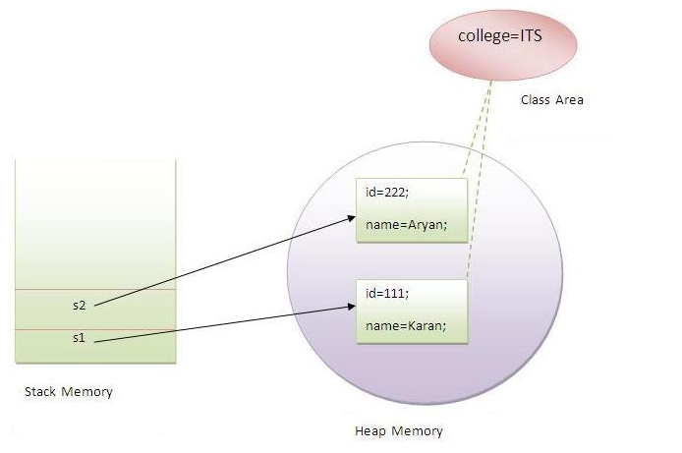
Example of static variable
class Student{
int rollno;
String name;
static String college ="ITS";
Student(int r,String n){
rollno = r;
name = n; }
void display (){
System.out.println(rollno+" "+name+" "+college);
}
public static void main(String args[]){
Student s1 = new Student(111,"Karan");
Student s2 = new Student(222,"Aryan");
s1.display();
s2.display(); } }

Slide 5
Static Methods
A static method belongs to the class rather than object of a class.
A class can have methods that are defined as static (e.g., main method).
Static methods can be accessed without using objects. Also, there is NO need to create objects.
static method can access static data member and can change the value of it.
They are prefixed with keyword “static”
Static methods are generally used to group related library functions that don’t depend on data members of its class. For example, Math library functions.

Slide 6
Example :1
class Student{
int rollno;
String name;
static String university = "ITS";
static void change(){
university = “Curaj"; }
Student(int r, String n){
rollno = r;
name = n;
}
void display ()
{
System.out.println(rollno+" "+name+" "+university);
}
public static void main(String args[]){
Student.change();
Student s1 = new Student (111,"Karan");
Student s2 = new Student (222,"Aryan");
Student s3 = new Student (333,"Sonoo");
s1.display();
s2.display();
s3.display();
}
}
Output:-
111 Karan Curaj
222 Aryan Curaj
333 Sonoo Curaj

Slide 7
Example: 2
class Calculate{
static int cube(int x){
return x*x*x;
}
public static void main(String args[]){
int result=Calculate.cube(5);
System.out.println(result);
}
}
Output :
125

